Slide 1
Notes:
I like to watch movies! Even more, I like to learn surprising facts about movie screenplays, actors, releases. It takes my breath away when I think about millions of profit and course losses production companies and investors deal with. How can somebody risk this money? Can a person be sure of the movie's profitability? I guess they can, but to which extent?
I work as a backend developer and I'm concluding my master thesis in software engineering, So, I can try to address these questions!

Slide 2

Prediction of a movie's box office using pre-release data
Master's Thesis (30 ECTS)
Presented by: Stanislav Bondarenko
Supervised by: Rajesh Sharma PhD
Tartu 2020
Notes:
Welcome everyone, I am Stanislav Bondarenko, thank you for joining my presentation on Predicting a movie’s box office using pre-release data. My supervisor is Rajesh Sharma.

Slide 3
Agenda
Motivation and goals
Data description
Used methods
Results
Discussion and conclusion
Notes:
The layout is going to be as follows. First, I want to explain in more detail what kind of problem we try to solve, which I hope will lead you towards the reasons for this research and the methods we were using. Then I will jump into the data description and the new features we created. I will spend some time on used methods, and continue with obtained results, that’s perhaps the biggest part. Finally, we will come to the conclusion and future recommendations. Let’s begin.

Slide 4
Motivation
Goals
Predict a movie’s box office at early stage of production which will allow to do adjustments to cast, crew, locations and general shooting process
Achieve comparable or better results than ones already published for the following tasks:
Binary classification: whether revenue will be higher than budget
Multi-class classification: to which one out of 9 ranges of revenue a movie is going to fall
Regression: predict the absolute revenue value
Notes:
The film industry in terms of revenue is very big, it doesn’t tend to decrease despite the wide usage of streaming services. It involves hard competition for the profit made and can be characterized by the strategy winner takes most. Setting ourselves in the place of an investor, we want to predict how profitable a movie is going to be, whether it worth taking the risk to invest in it, and how much to invest. These decisions are to be made before a movie's release, therefore the earlier we can predict a movie's revenue, the more adjustments can be made to cast, crew, locations, shooting process to make it as profitable as possible. So we consciously limit ourselves not to use such post-release data as different movie ratings, reviews, word-of-mouth data, opening box office, etc.
Profit, defined as revenue minus costs, includes multiple factors. But such revenue factors as tv deals, video on demand, and merchandise sales, as well as costs on marketing, distribution, interest, and taxes are considered to be trade secrets and are unavailable, or available in quite expensive and limited sets. So we narrow our revenue definition to all-time worldwide box office gross and cost definition to production cost.
We try to predict a movie's success in 3 different ways: whether the movie will be profitable, which range of revenue it’s likely to have, and predict the absolute value of a movie’s box office.

Slide 5
Data collection
Main source:
The Movie Database API (TMDB)
Additional sources:
The Numbers
Internet Movie Database (IMDb)
A Corpus of Movie Plot Synopsis with Tags (MPST)
Statistics:
Overall collected movies 485134
Movies with budget and box office information 8662
Usable movies: 7596
After outliers removal 6965
Notes:
There are many studies and even a Kaggle competition on movie rating prediction. They use such sources as IMDB, MovieLense, OMDb with tens of thousands of movies. While being good to predict rating, these data sources lack crucial for us budget and revenue information. The biggest to our knowledge dataset used in a study to predict revenue contains 4 thousand movies, but most studies use much smaller datasets specific to particular years or countries, or revenue size.
These studies try to predict a limited set of movies, so we felt the need to gather a more comprehensive dataset to have a more generalized view. After considering multiple options we decided to use The movie database API as the main source which allowed us to collect 8.5K movies which would at least have budget and revenue information. Based on the presence of other important features we cleaned the dataset to 7596 samples. Finally, after the outliers removal which will be explained later on, we obtained around 7 thousand movies to use.

Slide 6
Engineered features
Features calculated basing on previous movies
 | Avg profit | Avg revenue | # movies | Experience
Crew (x25) | ✓ | ✓ | ✓
Cast (x8) | ✓ | ✓ | ✓ | ✓
Production company (x3) | ✓ | ✓
Collection | ✓ | ✓
Other features:
Year’s average revenue
Average profit, revenue, experience and number of movies before aggregated over cast members
Competition
Notes:
To make these data usable by machine learning models, they should be converted to numerical representation, and we did it using best practices. Still, such useful nominal not ordered features as cast, crew, collection, production company are not feasible to represent in binary or any different encoding since the number of unique values is too big. Trying to make those values as representable as possible and do not violate our rule about pre-release data, we introduced new features described in the table. We calculated average profit and revenue based on previous movies of every given actor/director/collection etc. For the crew and cast members, we also calculated the number of previous movies, and experience for the cast in the number of years since the first movie.
Having a year’s average revenue allows us to skip inflation adjustments. And even more information comes from aggregating cast features. The competition reflects how many similar by genre movies are released within a week from a given one.

Slide 7
Outliers removal
Why:
The curse of target’s order of magnitude
It’s better to be good at predicting most of movies, than to be average in predicting all of the movies
How:
Budget and/or revenue less than $100K: 568 movies
Custom outliers removal technique on revenue related features: 63 movies
Notes:
Now, as promised, I’m going to tell about outliers removal. For example, we had 132 movies with revenue less than $1K together with 25 movies with revenue higher than $1B. Dataset of 7 thousand samples is extremely insufficient to predict the target with 9 orders of magnitude. Some authors deal with such a problem by having only 100 of the most profitable movies for each of several years or limiting the dataset to 2-3 orders of magnitude.
To address this problem while still preserving most of the movies, we removed 568 movies with a budget and/or revenue being less than $100K.
Out of explored outlier removal techniques, our invention showed the best result. We created lists of movies having profit-related features lower than the 1st decile or higher than the 9th decile, as well as limitations over other features. The best result was obtained by removing movies that fall into at least 15 of these lists, namely 63 movies.

Slide 8
Data pipelines
Regression
Filling missing input data with KNN Imputer
Yeo-Johnson power transformation of the input data with standardization
Yeo-Johnson power transformation of the target data with standardization
Classification with tree-based algorithms
Filling missing input data with KNN Imputer
Classification with neural networks
Filling missing input data with KNN Imputer
Yeo-Johnson power transformation of the input data with standardisation
Notes:
As you could expect, after performed feature engineering we have a high number of missing values and the majority of machine learning algorithms can’t work with it, so we must fill them. The best approach we found was to use a tuned k-Nearest Neighbors.
Other concerns to deal with are input scale and input distribution. While decision tree-based algorithms are invariant to the monotonic transformation of features, Neural networks and distance-based ones will suffer a lot from not normalized data. We standardize our input and regression target.
A drawback of the existing input distribution is high skewness for budget and revenue related features. We have a long tail of values on the right side, which most models try to reject as outliers and perform poorly in that region. The best way we found to handle it by transforming to a more normal-like distribution is Yeo-Johnson power transformation.

Slide 9
Model selection
Neural networks in general perform better. Is that true in our case?
We want to have more than 1 model at least for sanity check
Selected models:
Neural network (Keras implementation)
LightGBM
Hyperparameters tuning
Notes:
Now it’s time to tell what the models we were using. Many previous studies showed the superiority of neural networks, that influenced our decision to use it in our research.
Apart from using a neural network, we minimally tuned all Scikitlearn available regressors, xgboost and lightgbm to see how far we can get in designed tasks. We found LightGBM performing the best. What’s good is that both chosen algorithms can do both classification and regression tasks. We did a very extensive hyperparameters tuning using different parameter optimizers. The main findings related to the neural networks were to use a shallow architecture, small batch size, early stopping, dropout, and shifting learning rate. The main findings related to lightgbm were to use a high number of estimators, early stopping, to calibrate the leaves to depth ratio, and to use frequent bagging and subsampling.

Slide 10
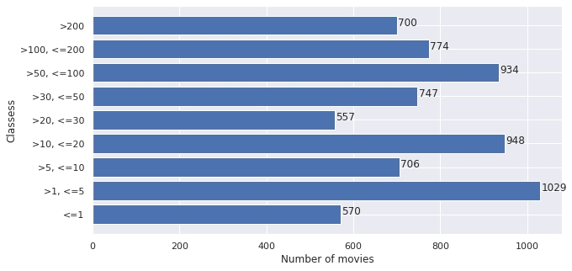
Targets
Regression Revenue
Classification
Binary Boolean whether the revenue is higher than budget
Multi-class 9 revenue categories (classes)
Notes:
Before going into results, I want to explain in more details what the targets we were using. The regression one, as it was said earlier, is the absolute revenue number. Binary classification target is a boolean value whether the revenue is higher than budget. About multi-class classification, a widely cited study of Sharda and Delen from 2006 gave a start to a set of studies that try to improve existing results. They used 9 different revenue classes, and we follow their example. On the table, you can see how many movies fall into which class. Class values are the number of millions of revenue. And as you can see, classes are more-less balanced, but we still use class weights while training our models. Well, now it’s time to show you the obtained results.

Slide 11
Results of 10-folds CV
 |  | Neural network | LightGBM
Regression * | SMAPE (%) WAPE (%) MAPE (%) MAE ($) | 65.868 42.625 192.5 32,162,029 | 54.821 32.411 149.725 24,457,248
Binary classification | Accuracy F1 AUC-ROC Precision Recall | 0.761 0.820 0.750 0.865 0.779 | 0.815 0.865 0.791 0.878 0.853
Multi-class classification | Accuracy F1 AUC-ROC Precision Recall 1-away accuracy | 0.363 0.333 0.833 0.378 0.362 0.757 | 0.433 0.429 0.861 0.427 0.433 0.804
* Regression on $10M to $100M revenue movies:
MAPE 41%, MAE $13.4M
Notes:
In the following table, you can see that LightGBM performs better on all of the 3 tasks. But before looking into the result numbers, I want to draw your attention to the metrics we used, their pros and cons. Mean absolute error (MAE) is easy to interpret, but it suffers from large magnitude errors. Predicting with a 10M error for a 1 million movie is much worse than prediction with the same error for a 100 million movie, while absolute error is the same. To abstract from absolute numbers, we use the Mean absolute percentage error (MAPE). But it over penalizes over-predictions and shoots up for movies with small actual revenue. Weighted absolute percentage error (WAPE) does the opposite and behaves similar to MAE. Symmetric absolute percentage error (SMAPE) addresses the shortcomings of the previous 2, but it’s hard to interpret it intuitively.
The values of regression metrics are quite scary actually, nobody would respect your prediction if it’s plus-minus 25 million. But we shouldn’t forget about the target’s magnitude and that most of that error comes from very big movies. For example, when we feed our lightgbm model only 10 to 100 million revenue movies (basically 1 order of magnitude target), we receive a MAE of 13 million and 41% MAPE, which is more-less okay.
Classification metrics are more straightforward and less biased due to the limited nature of the target. For the binary classification task, we have 69% positive samples, which makes it more beneficial for a model to predict more positives, which introduces more false positives than false negatives. But we want the opposite: the cost of predicting a flop movie being profitable is much higher than the cost of rejecting a profitable movie. Therefore we consciously sacrifice our accuracy (which could be 0.86) while being more strict and decreasing the number of false positives. We tuned our models on weighted classes, therefore precision and recall are approximately the same for multi-class classification. For multi-class classification, we also introduced 1 class away accuracy to compare with already published results.
Now I want to add some details about each of the tasks.

Slide 12
Binary classification
Results of averaging 10 folds of CV (696 samples in each fold)
Neural network | Predicted not profitable | Predicted profitable
Actual not profitable | 153.9 | 59.1
Actual profitable | 107.1 | 377.4
LightGBM | Predicted not profitable | Predicted profitable
Actual not profitable | 154.4 | 57.6
Actual profitable | 71 | 413.5
Notes:
At this table you can see the confusion matrix for each of 10 cross validation folds. As I said earlier, we want to decrease the number of false positives and we are ready to partially sacrifice accuracy for this. If you think of the results, it’s decent to predict 4 hundred profitables with just 50 false ones. Neural network performs worse, and when we adjust it to predict approximately the same number of true positives as lightgbm, the number of false negatives rapidly grows.

Slide 13
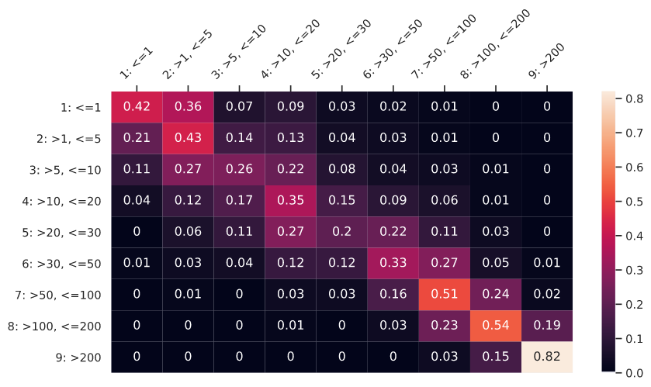
Multi-class classification
Average normalized confusion matrix for 10 CV folds
Notes:
Talking about multi-class classification, let’s explore the lightgbm confusion matrix. These are normalized numbers averaged over 10 cross validation folds. We can clearly see the desired diagonal line. But we also see the region of poor prediction, which is movies between 20 and 30 millions of revenue. Also it comes with no surprise that the last class with movies over 2 hundred million revenue has the highest accuracy, as the range is quite big. Now it’s time to look into regression graphs.

Slide 14
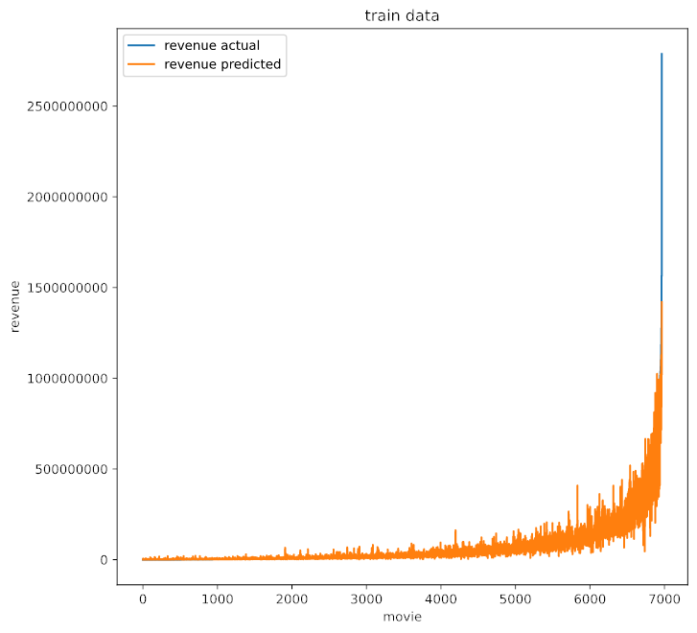
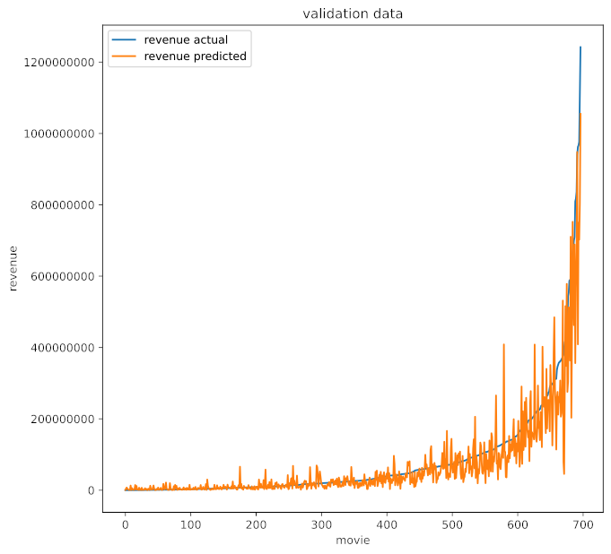
Regression
An example of one out of 10 CV folds
Predicting train data
Predicting test data
Notes:
Again, LightGBM predictions, but to make blue line of sorted actual revenue visible for test predictions, we show only one out of 10 cross validation folds. Anyway the graphs across folds are very similar. Orange line shows the predicted revenue values. From the right graph, we can see that model performs poorly around 200M revenue and above, but other regions are not that bad. But this scale hides a lot of information, let’s take a look on the log scaled graphs.

Slide 15
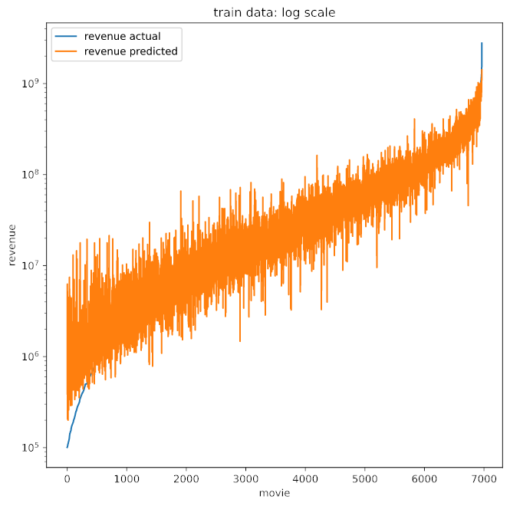
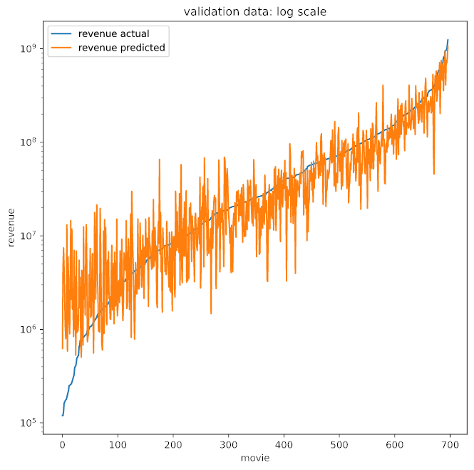
Regression
A log scaled example of one out of 10 CV folds
Predicting train data
Predicting test data
Notes:
From the right graph on test data, we see that model predictions are also very poor for movies below 10 millions, in fact it can’t predict ones below one million. And that’s the main source of percentage errors, as for example predicting a 2M revenue for 500 hundred thousand movie leads to 300% error. But the graph looks nice and we clearly see that it follows the actual revenue line on the most of regions. Let’s discuss these results in comparison with other studies.

Slide 16
Discussion of the results
All tasks were solved better by LightGBM
Binary classification results are better than already published ones (for pre-release data on box-office being higher than budget)
Multi-class classification results are very good, but worse than ones obtained by Parimi (2013) and Sharda (2006)
Regression task is an unexplored area (at least in academic world) and we set a good benchmark on it
Notes:
First, we couldn’t get better results from neural network, as other researchers did. The reason may be that they didn’t try lightgbm, or that we did something wrong.
Binary classification results are better than already published ones, if we take only those which used pre-release data with the target of box office being higher than budget.
Multi-class classification results are also good, better than most of already published ones, but worse than 2 studies. Superiority of the first one comes from using dynamic neural networks. And the second one uses a fusion model with voting system across multiple models. It’s something we can improve in future.
It’s hard to compare the regression results due to the absence of similar researches. Or rather they are present, but use very limited datasets, and we have seen that the results will significantly vary with the range of target. Or they use post-release features.

Slide 17
Conclusion
Future improvements
https://github.com/BondarenkoStas/thesis
The biggest dataset used in box office prediction task was collected
Set of new useful features was developed
Classification results are very competitive
Regression task results as a benchmark in the area of box office prediction on pre-release data
Pre-release SNS data (word-of-mouth, social media activity)
Granular feature selection
Number of theaters and screens
Marketing expenditure
Plot analysis
Star ratings
Looking inside the black box for interpretation
Notes:
So, what did we contribute to the field? We gathered the biggest to our knowledge dataset used in the box office prediction task and generated new sets of features that showed their usefulness. The classification task is not new in the field, and our results are quite competitive. But the regression task is an unexplored area, at least in the academic world, and we hope our study will set a benchmark for future researches.
You can also see what can be done better in future.

Slide 18
Questions from the oppontent’s report
Questions about methodology/ approach/ Evaluation
How come up with the custom outlier detection techniques? It seems like it is based on the errors, that is, removed outliers after prediction?
Why not used feature selection or dimensionality reduction methods such as PCA, UMAP etc as there are 228 columns in the dataset?
Table 1 and Table 4: What is the difference?
Some more questions
What motivated for choosing this problem statement?
It would be better if shown the results of other models as well as the results of these two models did not come up very good.
Which metrics is more important among Recall and Precision in your case in both multi-class and binary class problems and why?
Notes:
Opponent’s questions:
We tried many outlier removal technics such as isolation forest, one-class support vector machine, local outlier factor. We tried to tune them and use them in different combinations. Still, the drawback is that these technics tend to remove outliers that don’t have a big impact on the result. As opposite, in custom outlier removal technique we address the very reason for poor results which is the high order of magnitude of revenue-related features. And we managed to significantly improve our results by removing just 63 samples. At the end of the day, I think it’s better to predict most of the samples in a good way, then to predict all of the samples in an average way. We removed them based on the input data, not on the result we predicted on them.
We tried to use, unsuccessfully. PCA performs simple feature space rotation and assumes that data is linear, which is not true in our case. So it’s usage significantly worsens the results. t-SNA doesn’t work meaningfully with generating a space of more than 3 features. UMAP can potentially work, but we didn’t succeed to get better results with it, maybe it requires an exhaustive tuning, or maybe it just won’t work in our case. In fact, we did feature selection based on missing value ratio, low variance filter. We applied many recursive feature elimination techniques using random forest and lightgbm which give us feature importances. But the fact is that the best results were archived on 190-200 features with only discarding some tags and genres. So we just decided to keep the feature space as is, maybe with some modifications in future. We state that all of the engineered sets of features increase models’ performance.
No, it’s a mistake, I forgot to delete it after moving to the subsection’s end. In fact table 1 is not referred to in the text.
We tried to solve not a simple machine learning task, but to make it close to real life, where an investor is interested to predict profitability before making an actual investment before most of the work is already done and there isn’t much can be changed.
The shown results are the best from what I have, other models perform worse, so I guess it doesn’t make sense to show them.
Precision is inversely proportional to the number of false positives which are far less desired than false negatives. And recall is inversely proportional to the number of false negatives. So increasing the precision metric is more important in our case for binary classification.
But it’s not very correct to compare precision and recall in multi-class classification. We take average precision from each class, which is different from the binary tasks when we take precision only from positive ones. Therefore by making our model more strict for one class and having fewer false positives, we inevitably introduce more false positives for other classes. In fact, if classes are balanced average precision and recall will be approximately the same.

